Slide 1

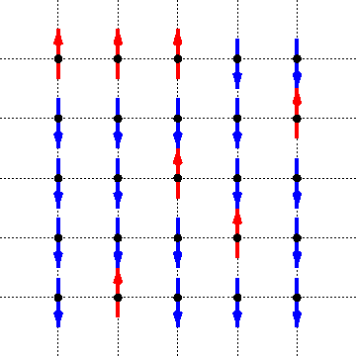
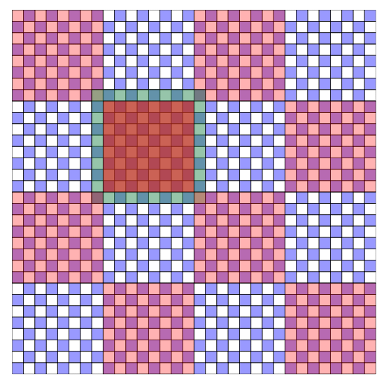

Ising Model Parallelization
Sean Rivera (CS undergrad) & Honghua Yang (Phys Grad)
Ising model: a mathematical model describing magnetism.
Magnetic moments of each atom can be represented by an arrow in the graph below.
The total energy of the system is given by
Parallelizing will be done through blocks.
Ising model illustration
parallelization
http://www.math.ubc.ca/~andrewr/research/intro_html/node14.html
Martin Weigel, J. Comput. Phys. 231, 3064 (2012)

